Slide 1

CYBER SECURITY
PROFFESIONAL
COMMUNICATION
BIBIN BENNY
CSE 20

Slide 2
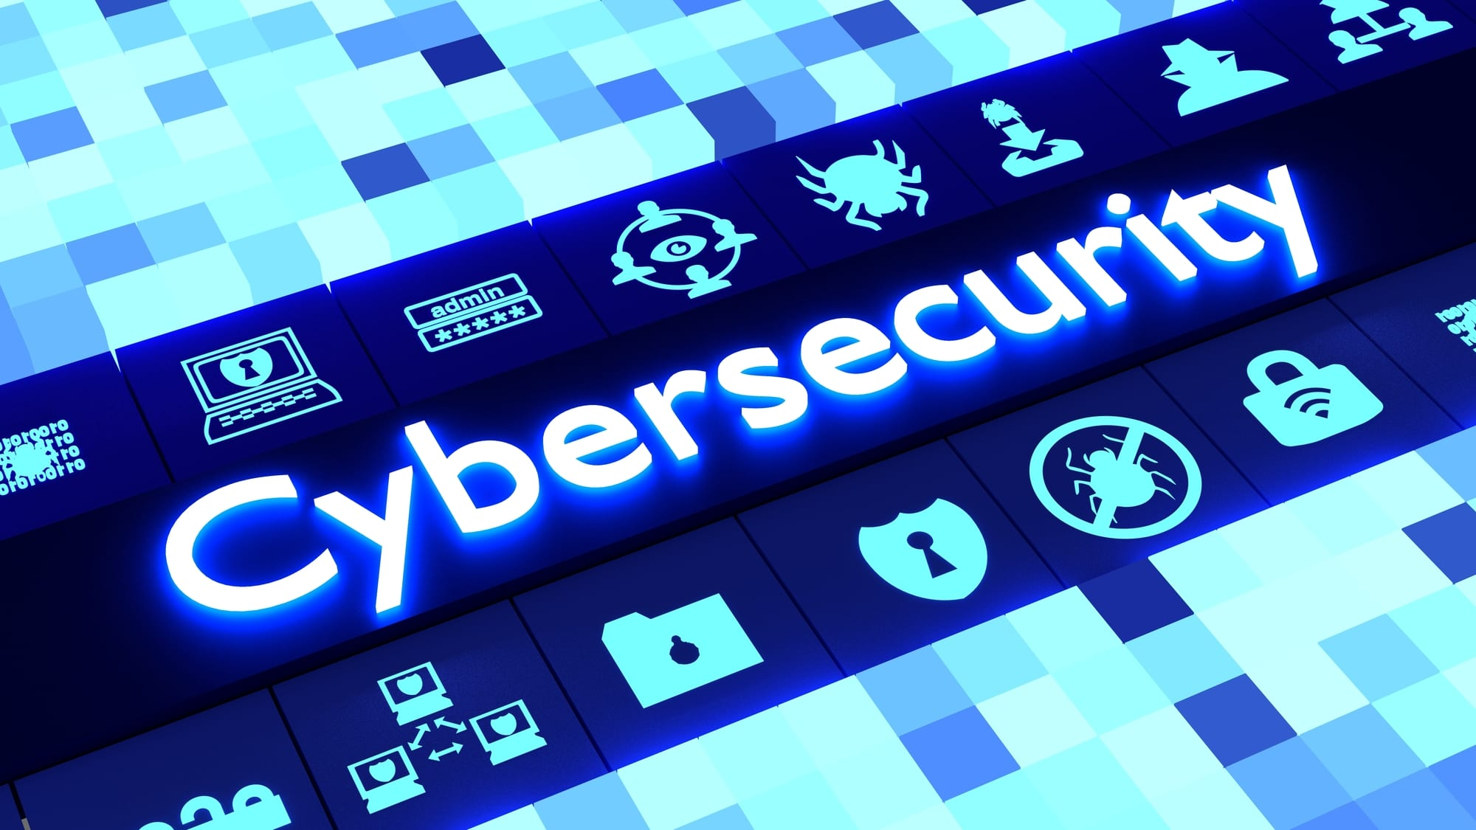
WHAT IS CYBER SECURITY ?
Cyber security standards are security standards which enable organizations to practice safe security techniques to minimize the number of successful cyber security attacks.
This Photo by Unknown Author is licensed under CC BY-SA-NC

Slide 3
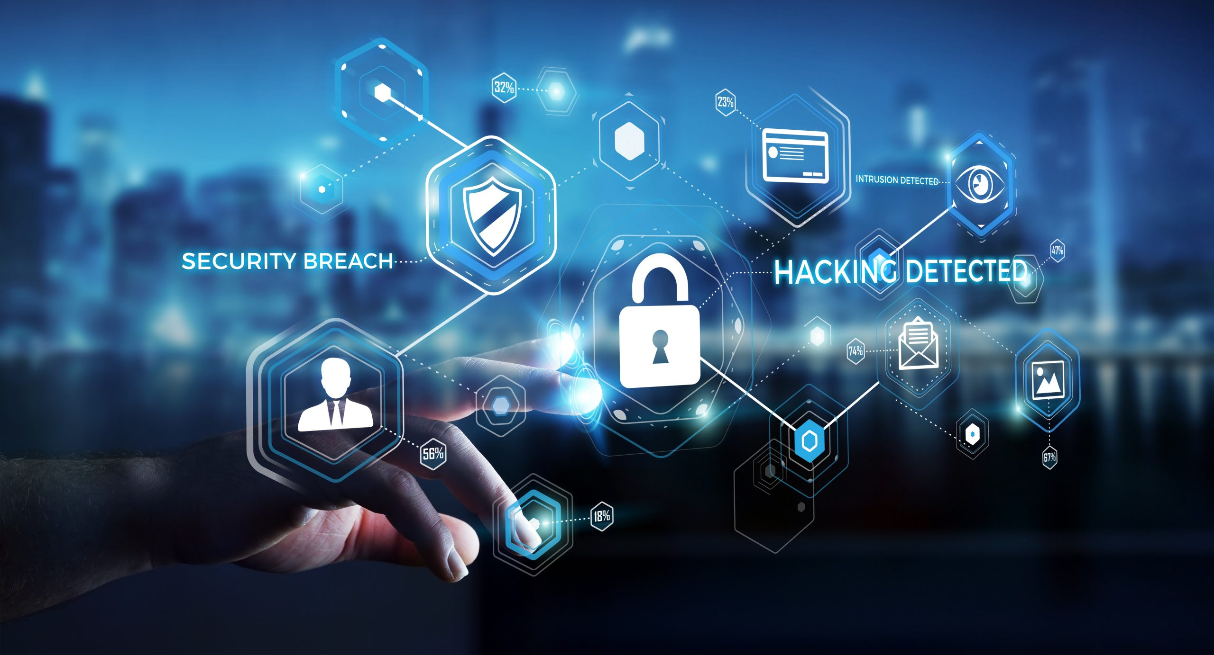
Cyber security refers to the technologies and processes designed to protect computers, networks and data from unauthorized access, vulnerabilities and attacks delivered via the internet by cyber criminals.
Though cyber security is important for network, data and application security.
This Photo by Unknown Author is licensed under CC BY-SA

Slide 4
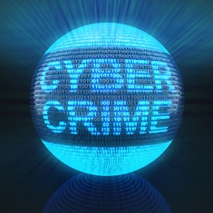
WHAT IS CYBER CRIME ?
Use of a computer /internet to do something that would be a crime in any case.
Basic examples:
Credit card fraud
Identity theft
Spam
Viruses

Slide 5
CYBER SECURITY THREATS
These threats are able to operate in security failures and damages to the assets of a user
Examples
Hacking
Malware
Phishing
Virus

Slide 6
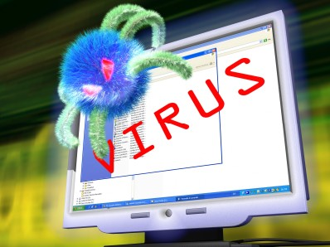
VIRUS
A virus is a program that is loaded onto your computer without your knowledge and runs against your wishes.
SOLUTION
Install a security suite that protects the computer
against such threats.
This Photo by Unknown Author is licensed under CC BY-SA-NC

Slide 7

HACKERS
Hacker is a person who breaks into computersss,usually by gaining access to administrative controls.
How to prevent hacking
It may be impossible to prevent computer
Hacking , however effective security controls
including strong passwords, and the use of firewalls
can help.
This Photo by Unknown Author is licensed under CC BY

Slide 8
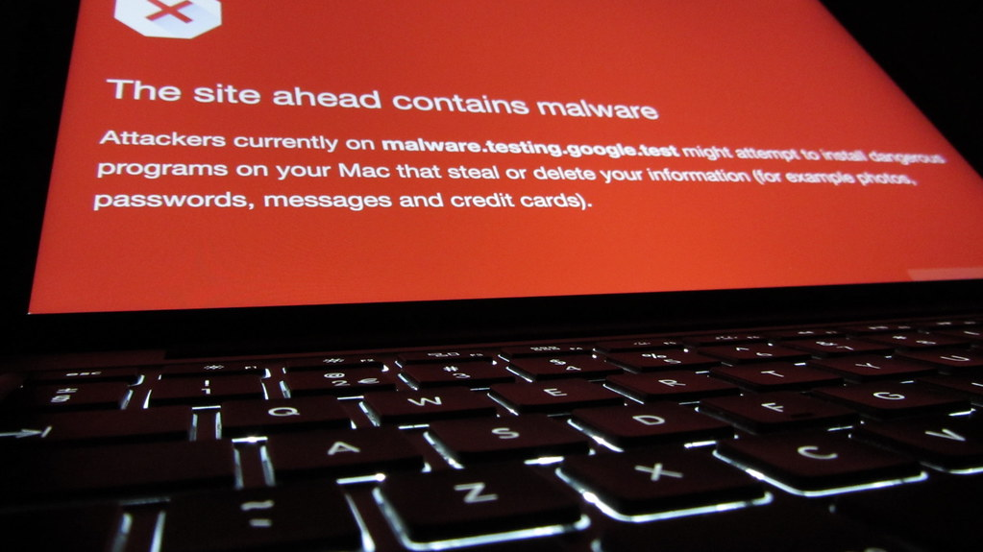
MALWARE
The word “malware” comes from the term “MALicious software.”
Malware is any software that infects and damages a computer system without the owner’s knowledge or permission.
This Photo by Unknown Author is licensed under CC BY-SA

Slide 9
TO STOP MALWARE
Download an anti-malware program that also helps prevent infections.
Activate network threat protection,firewall,antivirus.

Slide 10
DIFFERENT KINDS OF ATTACK
Phishing-Technique to gain personal information for the purpose of identity theft
What they are after:
Name and username
Address and phone number
Password and pin
Bank account number
ATM/debit card number
Credit card validation code (CVC)

Slide 11
HOW CAN WE PREVENT CYBER CRIME?
Don’t click on links in suspicious emails.
Understand that your smartphone is also vulnerable.
Keep all personal information to yourself.
Do not connect to Wi-Fi from external parties.
Credit card offer better protection than debit cards.

Slide 12
BENEFITS OF CYBER SECURITY
Protect personal and sensitive information of the user
Decrease the threat of current and future vulnerability
Comprehensive digital protection to the user
Secure from the viruses
Creates job opportunities

Slide 13
REFRENCES
https://m.youtube.com/watch?v=i_HXI8dFUnk
https://m.youtube.com/watch?v=ooJSgsB5fIE
https://m.youtube.com/watch?v=U_P23SqJaDc

Slide 14
THANK
YOU

